Slide 1
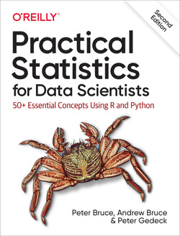

Slide 2
Github link
https://github.com/gedeck/practical-statistics-for-data-scientists

Slide 3
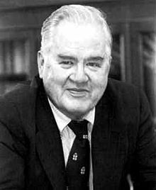
Exploratory Data Analysis
John Tukey, the eminent statistician whose ideas developed over 50 years ago form the foundation of data science.
The field of exploratory data analysis was established with Tukey’s 1977 now-classic book Exploratory Data Analysis.
Tukey presented simple plots (e.g., boxplots, scatterplots) that, along with summary statistics (mean, median, quantiles), help paint a picture of a data set.
John Tukey

Slide 4
Elements of Structured Data
Data comes from many sources: Sensors,Video,events etc
Data is unstructured : Image,Text,Clickstream
A major challenge of data science is to harness this torrent of raw data into actionable information. To apply the statistical concepts , unstructured raw data must be processed and manipulated into a structured form.
One of the commonest forms of structured data is a table with rows and columns—as data might emerge from a relational database

Slide 5
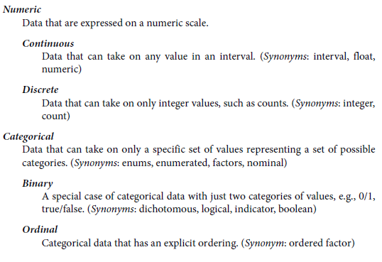
Data Types
Data type is important to help determine the type of visual display, data analysis, or statistical model
Notes:
The pandas documentation describes the different data types and how they can
be manipulated in Python.

Slide 6
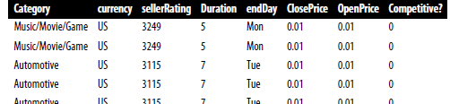
Rectangular Data
The typical frame of reference for an analysis in data science is a rectangular data object, like a spreadsheet or database table.
Rectangular data is the general term for a two-dimensional matrix with rows indicating records (cases) and columns indicating features (variables); data frame is the specific format in R and Python.
A typical data frame format

Slide 7
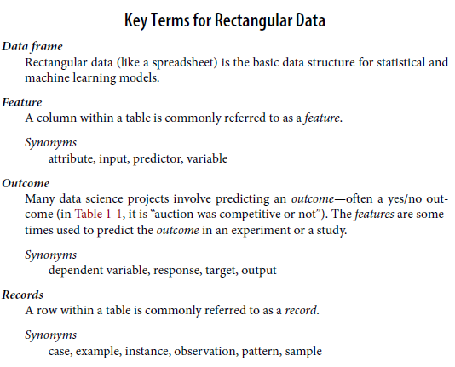

Slide 8
Nonrectangular Data Structures
Spatial data structures, which are used in mapping and location analytics, are more complex and varied than rectangular data structures
Graph (or network) data structures are used to represent physical, social, and abstract relationships. For example, a graph of a social network, such as Facebook or LinkedIn
Each of these data types has its specialized methodology in data science.

Slide 9
Estimates of Location
A basic step in exploring your data is getting a “typical value” for each feature (variable): an estimate of where most of the data is located (i.e., its central tendency).

Slide 10
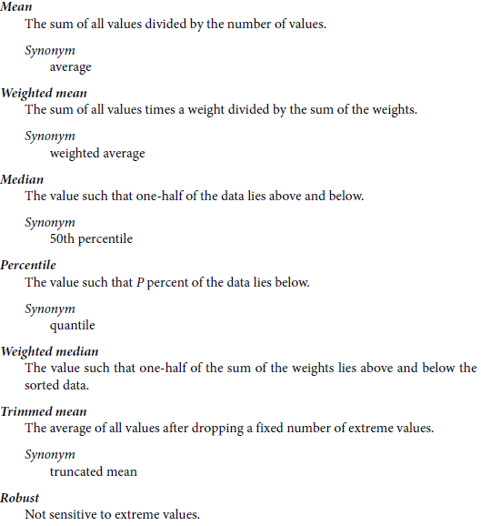

Slide 11
Mean
The most basic estimate of location is the mean, or average value. The mean is the sum of all values divided by the number of values.
Consider the following set of numbers:
{3 5 1 2}. The mean is (3 + 5 + 1 + 2) / 4 = 11 / 4 = 2.75.
The formula to compute the mean for a set of n values x1, x2, ..., xn is:
Mean = x =Σi=1n xi / n
N (or n) refers to the total number of records or observations

Slide 12

Trimmed mean
A variation of the mean is a trimmed mean, which you calculate by dropping a fixed number of sorted values at each end and then taking an average of the remaining values.
A trimmed mean eliminates the influence of extreme values.
Representing the sorted values by x 1 , x 2 , ..., x n where x 1 is the smallest value
and x n the largest, the formula to compute the trimmed mean with p smallest and
largest values omitted is:

Slide 13

Weighted Mean
calculate by multiplying each data value xi by a user-specified weight wi and dividing their sum by the sum of the weights. The formula for a weighted mean is:

Slide 14
Median and Robust Estimates
The median is the middle number on a sorted list of the data. If there is an even number of data values, the middle value is one that is not actually in the data set, but rather the average of the two values that divide the sorted data into upper and lower halves.
Compared to the mean, which uses all observations, the median depends only on the values in the center of the sorted data.
Reflection : median is a better metric for location?

Slide 15
Outlier
median is referred to as a robust estimate:-not influenced by outliers (extreme cases) that could skew the results.
An outlier is any value that is very distant from the other values in a data set
Reflection : Is median the only robust estimate of location?
The basic metric for location is the mean, but it can be sensitive to extreme values (outlier).
• Other metrics (median, trimmed mean) are less sensitive to outliers and unusual distributions and hence are more robust.

Slide 16
Estimates of Variability
Location is just one dimension in summarizing a feature. A second dimension, variability,also referred to as dispersion, measures whether the data values are tightly clustered or spread out.
Key Terms for Variability Metrics
Deviations The difference between the observed values and the estimate of location.
Synonyms : errors, residuals
Variance The sum of squared deviations from the mean divided by n – 1 where n is the number of data values.
Synonym : mean-squared-error
Standard deviation : The square root of the variance.

Slide 17
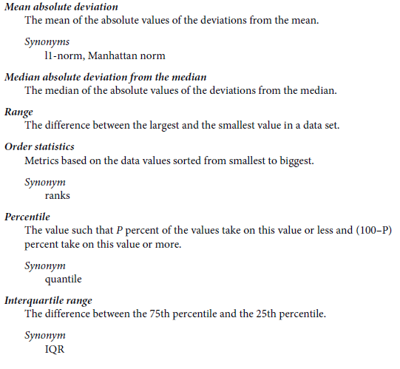

Slide 18


Deviations, between the estimate of location and the observed data.
For a set of data {1, 4, 4}, the mean is 3 and the median is 4. The deviations from the mean are the differences: 1 – 3 = –2, 4 – 3 = 1, 4 – 3 = 1. These deviations tell us how dispersed the data is around the central value.
The sum of the deviations from the mean is precisely zero.
A simple approach is to take the average of the absolute values of the deviations from the mean.
The absolute value of the deviations is {2 1 1}, and their average is (2 + 1 + 1) / 3 = 1.33. This is known as the mean
absolute deviation and is computed with the formula:

Slide 19
Reflection : standard deviation is preferred in statistics over the mean absolute deviation?
Note :
The variance, the standard deviation, nor the mean absolute deviation is robust to outliers and extreme values
The variance and standard deviation are especially sensitive to outliers since they are based on the squared deviations.
Degrees of Freedom, and n or n – 1?

Slide 20
Median Absolute Deviation
The median absolute deviation from the median or MAD:
Median absolute deviation = Median x1 − m , x2 − m , ..., xN − m
where m is the median. Like the median, the MAD is not influenced by extreme values.

Slide 21
Estimates Based on Percentiles
Statistics based on sorted (ranked) data are referred to as order statistics.
A different approach to estimating dispersion is based on looking at the spread of the sorted data
range: the difference between the largest and smallest numbers
But the range is extremely sensitive to outliers and not very useful as a general measure of dispersion in the data.

Slide 22
Percentile
To avoid the sensitivity to outliers, we can look at the range of the data after dropping values from each end.
The percentile is essentially the same as a quantile, with quantiles indexed by fractions (so the .8 quantile is the same as the 80th percentile).
Note that the median is the same thing as the 50th percentile.
A common measurement of variability is the difference between the 25th percentile and the 75th percentile, called the interquartile range (or IQR)
e.g.{1,2,3,3,5,6,7,9}. The 25th percentile is at 2.5, and the 75th percentile is at 6.5, so the interquartile range is 6.5 – 2.5 = 4.

Slide 23
Exploring the Data Distribution
Each of the estimates we’ve covered sums up the data in a single number to describe the location or variability of the data. It is also useful to explore how the data is distributed overall.

Slide 24
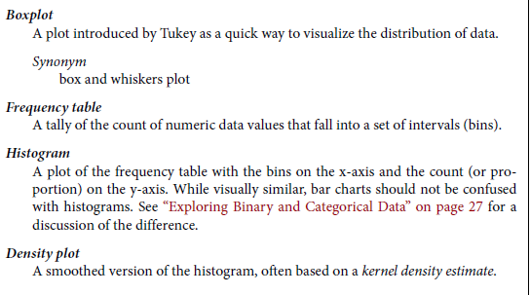

Slide 25
Percentiles and Boxplots
Box Plots: based on percentiles and give a quick way to visualize the distribution of data.

Slide 26
Frequency Table and Histogram
A frequency table of a variable divides up the variable range into equally spaced segments and tells us how many values fall within each segment.
A histogram is a way to visualize a frequency table, with bins on the x-axis and the data count on the y-axis.

Slide 27
Note
In statistical theory, location and variability are referred to as the first and second moments of a distribution. The third and fourth moments are called skewness and kurtosis. Skewness refers to whether the data is skewed to larger or smaller values, and kurtosis indicates the propensity of the data to have extreme values. Generally, metrics are not used to measure skewness and kurtosis; instead, these are discovered through visual display.

Slide 28
Density Plot
It shows the distribution of data values as a continuous line.
A density plot can be thought of as a smoothed histogram, although it is typically computed directly from the data through a kernel density estimate.

Slide 29
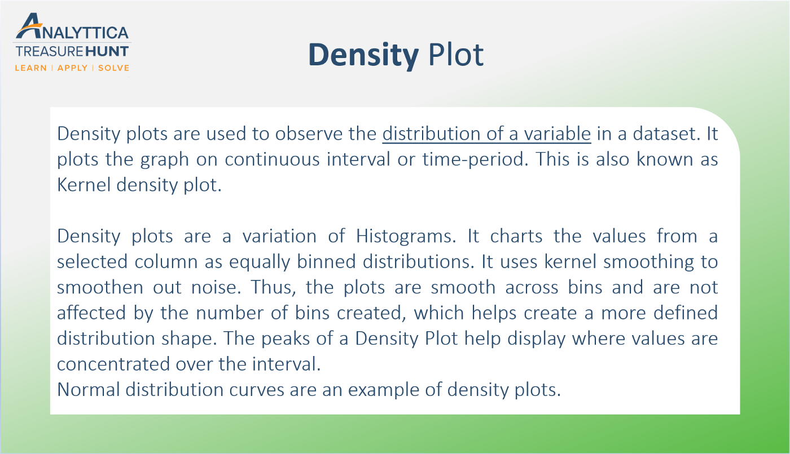

Slide 30
1.2

Slide 31
Exploring Binary and Categorical Data
Mode : The most commonly occurring category or value in a data set.
Expected value: When the categories can be associated with a numeric value, this gives an average value based on a category’s probability of occurrence.
Bar charts :The frequency or proportion for each category plotted as bars.
Pie charts : The frequency or proportion for each category plotted as wedges in a pie.

Slide 32
Percentage of delays by cause at Dallas/Fort Worth Airport
Carrier ATC Weather Security Inbound
23.02 30.40 4.03 0.12 42.43
Bar Chart : common visual tool for displaying a single categorical variable. Categories are listed on the x-axis, and frequencies or proportions on the y-axis.
Note : Note that a bar chart resembles a histogram; in a bar chart the x-axis represents different categories of a factor variable, while in a histogram the x-axis represents values of a single variable on a numeric scale. In a histogram, the bars are typically shown touching each other, with gaps indicating values that did not occur in the data. In a bar chart, the bars are shown separate from one another.
Pie charts are an alternative to bar charts, although statisticians and data visualization experts generally eschew pie charts as less visually informative

Slide 33
Mode
The mode is the value—or values in case of a tie—that appears most often in the data.
The mode is a simple summary statistic for categorical data, and it is generally not used for numeric data.

Slide 34
Expected value
The expected value is calculated as follows:
1. Multiply each outcome by its probability of occurrence.
2. Sum these values.
EV = 0 . 05 300 + 0 . 15 50 + 0 . 80 0 = 22 . 5

Slide 35
correlation
Correlation coefficient
A metric that measures the extent to which numeric variables are associated with one another (ranges from –1 to +1).
Correlation matrix
A table where the variables are shown on both rows and columns, and the cell values are the correlations between the variables.

Slide 36

Pearson’s correlation coefficient
Pearson’s correlation coefficient, we multiply deviations from the mean for variable 1 times those for variable 2, and divide by the product of the standard deviations:

Slide 37
Scatterplots
The standard way to visualize the relationship between two measured data variables is with a scatterplot. The x-axis represents one variable and the y-axis another, and each point on the graph is a record.

Slide 38
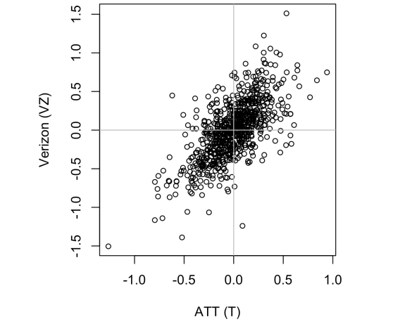
Scatter Plot
Scatterplots are a straightforward way to visualize the data distribution in a XY plane, especially when we are looking for trends or clusters. But when you have a dataset with a large number of points, many of these data points can overlap. This overalpping effect can make difficult to see any trends or clusters.

Slide 39
Exploring Two or More Variables
One Variable : mean ,variance etc
Two Variable : Correlation
Multivariate : depends on the nature of the data: numeric versus categorical.

Slide 40
Key Terms
Contingency table : A tally of counts between two or more categorical variables.
Hexagonal binning : A plot of two numeric variables with the records binned into hexagons.
Contour plot : A plot showing the density of two numeric variables like a topographical map.
Violin plot : Similar to a boxplot but showing the density estimate.

Slide 41
Binning
Binning is a technique of data aggregation used for grouping a dataset of N values into less than N discrete groups. In this article we are considering only the case of datasets build up of (x,y) points distributed on a XY plane, but this technique is applicable in other cases. This technique is based on extremely simple concepts.
the XY plane is uniformly tiled with polygons (squares, rectangles or hexagons).
the number of points falling in each bin (tile) are counted and stored in a data structure.
the bins with count > 0 are plotted using a color range (heatmap) or varying their size in proportion to the count.

Slide 42
Hexagonal Binning
Scatterplots are fine when there is a relatively small number of data values. For data sets with hundreds of thousands or millions of records, a scatterplot will be too dense, so we need a different way to visualize the relationship.
hexagonal binning:Rather than plotting points, which would appear as a monolithic dark cloud, we grouped the records into hexagonal bins and plotted the hexagons with a color indicating the number of records in that bin.

Slide 43
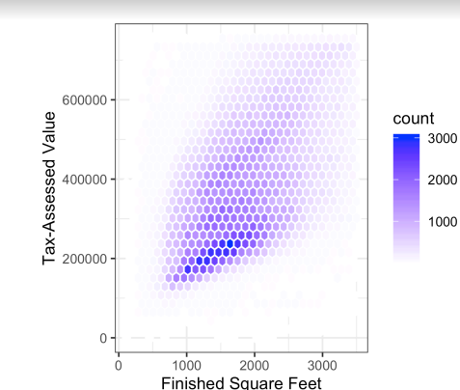
Hexagonal binning
Data sets with hundreds of thousands or millions of records, a scatterplot will be too dense, so we need a different way to visualize the relationship.
Hexagonal binning is a plot of two numeric variables with the records binned into hexagons.
Rather than plotting points, records are grouped into hexagonal bins and color indicating the number of records in that bin.

Slide 44
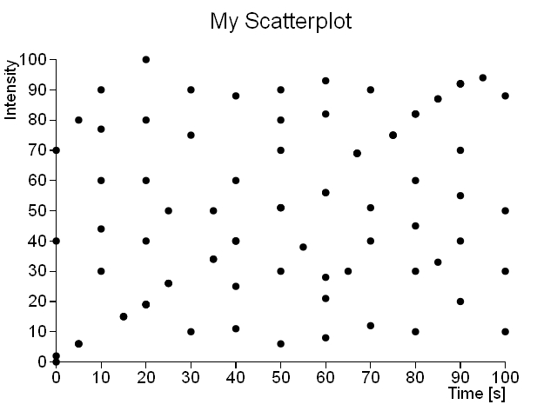
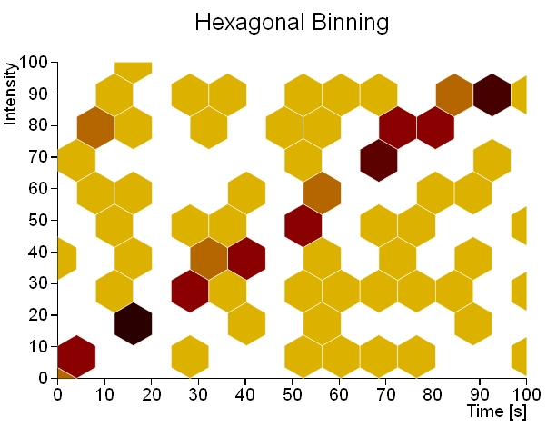
Scatter plot vs hexagon Binning
White bins are the bins where there is no data (count = 0).a linear trend is visible.

Slide 45
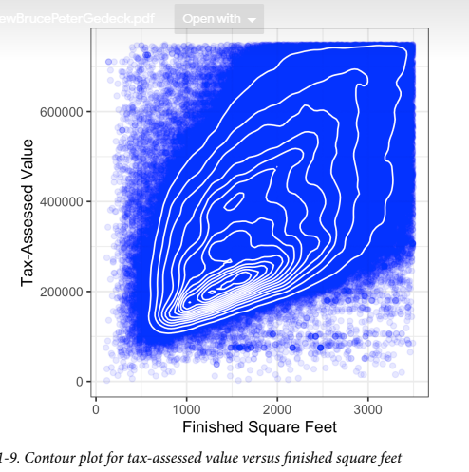
Contours
The contours are essentially a topographical map to two variables; each contour band represents a specific density of points, increasing as one nears a “peak.”

Slide 46
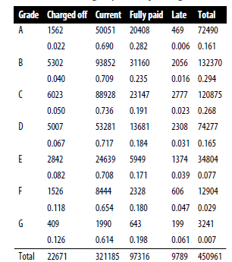
Two Categorical Variables
A useful way to summarize two categorical variables is a contingency table—a table of counts by category. Table shows the contingency table between the grade of a personal loan and the outcome of that loan.
Contingency tables can look only at counts, or
they can also include column and total percentages.
Pivot tables in Excel are perhaps the most common
tool used to create contingency tables.

Slide 47
Categorical and Numeric Data
Box Plot are a simple way to visually compare the distributions of a numeric variable grouped according to a categorical variable.
A violin plot, introduced by [Hintze-Nelson-1998], is an enhancement to the boxplot and plots the density estimate with the density on the y-axis.
The density is mirrored and flipped over, and the resulting shape is filled in, creating an image resembling a violin.

Slide 48
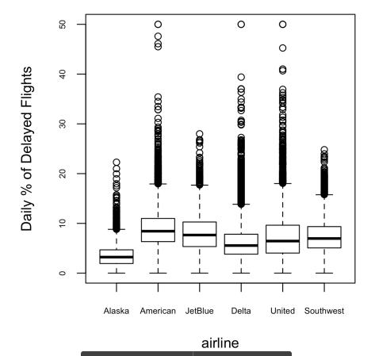
Box plot
Visually compare the distributions of a
numeric variable grouped according
to a categorical variable.

Slide 49
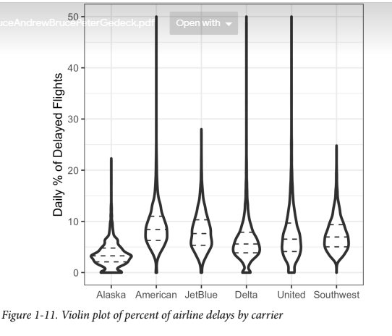

Slide 50
Visualizing Multiple Variables
The types of charts used to compare two variables—scatterplots, hexagonal binning, and boxplots—are readily extended to more variables through the notion of conditioning.

Slide 51
Summary
Hexagonal binning and contour plots are useful tools that permit graphical
examination of two numeric variables at a time, without being overwhelmed by
huge amounts of data.
Contingency tables are the standard tool for looking at the counts of two catego‐
rical variables.
Boxplots and violin plots allow you to plot a numeric variable against a categori‐
cal variable.

